Slide 1
Long-Tailed Classification by Keeping the Good and Removing the Bad Momentum Causal Effect
Kaihua Tang¹, Jianqiang Huang^{1,2}, Hanwang Zhang¹
¹Nanyang Technological University
²Damo Academy, Alibaba Group
Github: https://github.com/KaihuaTang/Long-Tailed-Recognition.pytorch
Notes:
Hello, everyone, today I’m going to introduce our work long-tailed classification XXXXX

Slide 2
Contents
Long-Tailed Classification
Related Work
The Proposed Causal Graph
De-confound TDE
Advantages
Notes:
First

Slide 3
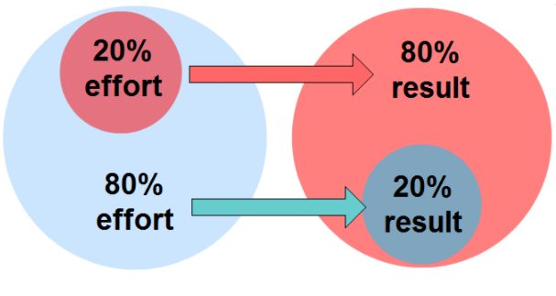
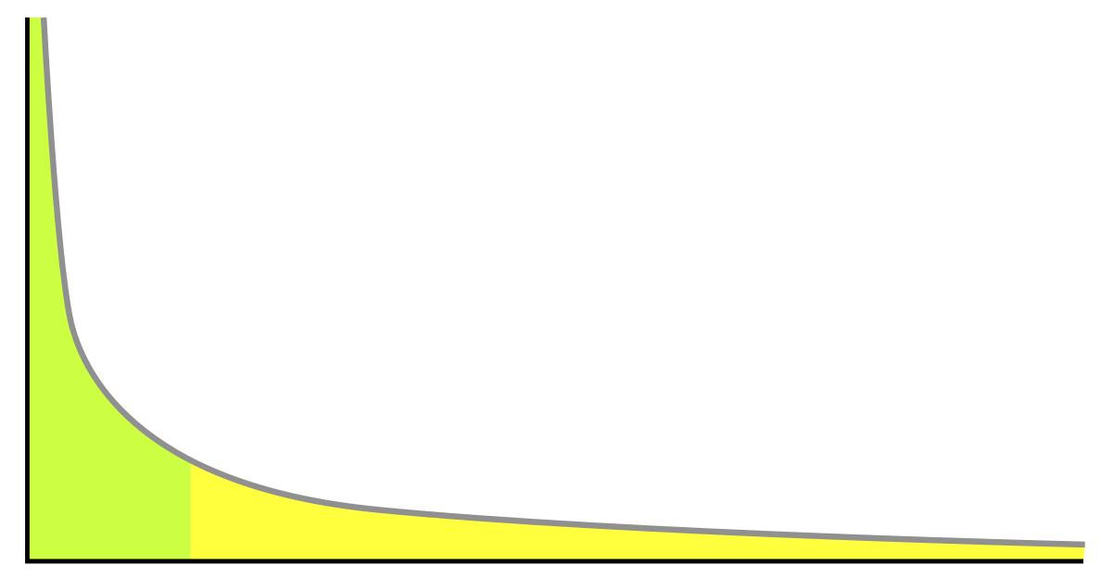
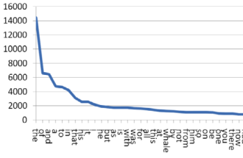

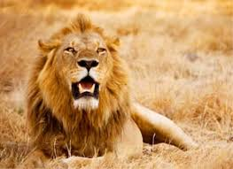

Long-Tailed Distribution
What is long-tailed distribution?
NLP $→$ Zipf’s Law
Economics $→$ Pareto Principle
Computer Vision
Head Classes
(Most of the data)
Tail Classes (Most of the categories)
Notes:
What is lt…
It’s a ubiquitous unbalanced distribution in all kinds of data

Slide 4
Contents
Long-Tailed Classification
Related Work
The Proposed Causal Graph
De-confound TDE
Advantages
Notes:
In previous work

Slide 5
Related Work
The most common solutions:
Re-sampling
Re-weighting
A recent paper proposes a two-stage strategy^{[1]}:
Stage 1: train backbone feature extractor on original data
Stage 2: finetune classifier on balanced data
Drawbacks:
Under-fitting to the head
Over-fitting to the tail
[1] Kang, Bingyi, et al. "Decoupling Representation and Classifier for Long-Tailed Recognition." ICLR. 2019.
Notes:
The most common solutions are ….
However, they may cause……
A recent paper found that the two-stage strategy can partially solve this problem, they

Slide 6

They fail to explain the whys and wherefores of their solutions:
What’s the problem of existing methods?
why is the re-balanced classifier good but the re-balanced feature learning bad?
why does the two-stage training significantly outperform the end-to-end one in long-tailed classification?
Notes:
But what’s the problem of all these existing methods:
They fail
For example
1.
2.

Slide 7
Accumulative Momentum Effect
SGD Momentum in
Balanced Dataset
SGD Momentum in
Long-Tailed Dataset
Global Optima for All Categories
Local Optima for Head Categories
Momentum Direction in Balanced Data
Momentum Direction in Long-Tailed Data
Notes:
In this work,
we are not just going to propose a single stage solution,
But also explain the whys of long-tailed problems
We believe the accumulative momentum effect is the reason of XXXX,
Especially, when we use SGD optimizer with momentum
Here is an example,

Slide 8
Contents
Long-Tailed Classification
Related Work
The Proposed Causal Graph
De-confound TDE
Advantages
Notes:
Since SGD momentum is very useful in stabilizing the training,
so we are going to construct a causal graph and only remove its bad causal effects

Slide 9
The Proposed Causal Graph
M
X : Feature
Y : Prediction
M: Momentum
D : Projection on Head
D
X
Y
Notes:
M will change the para of backbone, which determine the value of X
Due to the M effect, X will be deviated to the head direction,
which eventually cause the bias in Y

Slide 10
Contents
Long-Tailed Classification
Related Work
The Proposed Causal Graph
De-confound TDE
Advantages
Notes:
What’s the problem of this causal graph

Slide 11
Two Undesired Causal Effects of Momentum
M
Two Undesired Causal Effects of Momentum：
Backdoor shortcut
D
X
Y
Notes:
There are two XXXXXX

Slide 12
Two Undesired Causal Effects of Momentum
M
Two Undesired Causal Effects of Momentum：
Backdoor shortcut
Indirect Mediator Effect
D
X
Y

Slide 13
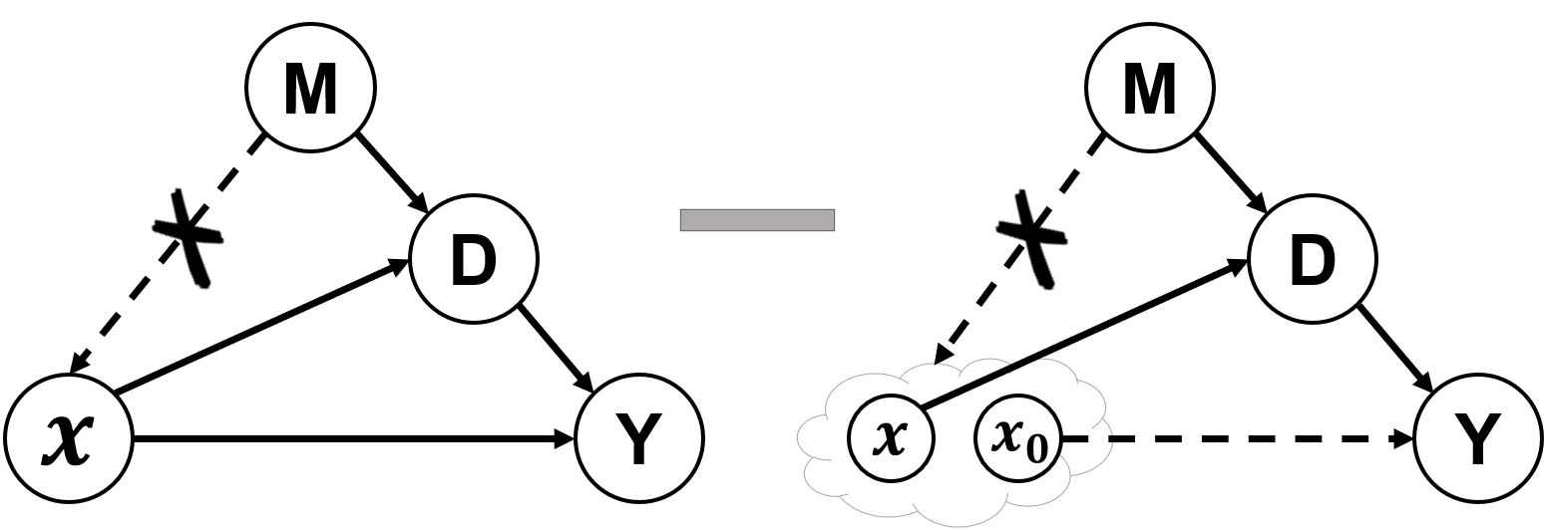
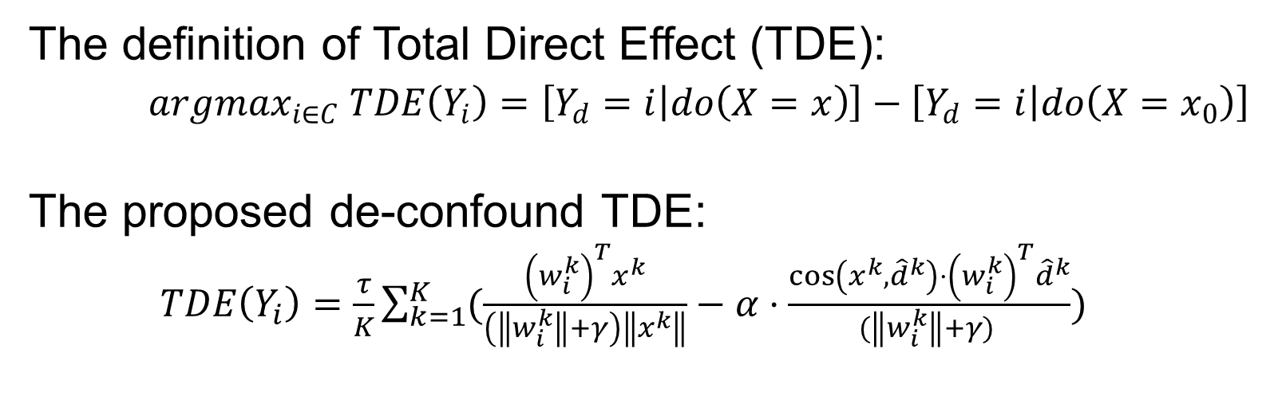
De-confound TDE Classifier
The definition of Total Direct Effect (TDE):
$argmax_{i∈C} TDE\left(Y_{i}\right)=\left[Y_{d}=i | do\left(X=x\right)\right]−\left[Y_{d}=i | do\left(X=x_{0}\right)\right]$
The proposed de-confound TDE:
$TDE\left(Y_{i}\right)=\frac{τ}{K}\sum_{k=1}^{K}{(\frac{{\left(w_{i}^{k}\right)}^{T}x^{k}}{\left(\left\|w_{i}^{k}\right\|+γ\right)\left\|x^{k}\right\|}−α⋅\frac{{\cos\left(x^{k},{\hat{d}}^{k}\right)⋅\left(w_{i}^{k}\right)}^{T}{\hat{d}}^{k}}{(\left\|w_{i}^{k}\right\|+γ) })}$
Notes:
Therefore, we propose a new classifier to estimate the TDE that removes these two bad momentum effects

Slide 14
Contents
Long-Tailed Classification
Related Work
The Proposed Causal Graph
De-confound TDE
Advantages
Notes:
There are several advantages of the proposed de-confound TDE

Slide 15
Advantages
The proposed de-confound TDE simple, adaptive, and agnostic to the prior statistics of the class distribution:
It doesn’t introduce any additional stages or modules.
It can be applied to a variety of tasks, including but not limited to image classification, object detection, instance segmentation.
It doesn’t rely on the accessibility of data distribution.
We outperform previous state-of-the-arts: Decoupling^{[1]}, BBN^{[2]} and EQL^{[3]} on ImageNet-LT, Long-Tailed CIFAR-10/-100, and Large Vocabulary Instance Segmentation (LVIS) dataset.
[1] Kang, Bingyi, et al. "Decoupling Representation and Classifier for Long-Tailed Recognition." ICLR. 2019.
[2] Zhou, Boyan, et al. "BBN: Bilateral-Branch Network with Cumulative Learning for Long-Tailed Visual Recognition." CVPR. 2020.
[3] Tan, Jingru, et al. "Equalization Loss for Long-Tailed Object Recognition." CVPR. 2020.

Slide 16


Thank You
Code Link
Paper Link
Notes:
Thank you for your patience, if you are interested in our work, please scan the QR code for our project link and paper link.

